Slide 1
INF3201: Information Systems Audit and Control
Week 1 - 2: The Process of Auditing Information Systems

Slide 2
Risk-based IT audit strategy
The essence of a risk-based audit plan lies in its ability to anticipate and mitigate risks in a rapidly evolving IT landscape.
Such a plan is not merely a procedural requirement but a strategic tool instrumental in safeguarding an organization’s digital assets and ensuring compliance with regulatory standards.
It necessitates a forward-looking perspective that aligns with the organization’s immediate and long-term goals.

Slide 3
The process begins with identifying key risk areas within an organization’s IT framework to pinpoint potential vulnerabilities and areas where the organization is most susceptible to risks, be it in data security, system integrity, or compliance with regulations.
This requires a comprehensive analysis of the organization’s IT infrastructure, including a detailed understanding of various systems, applications, and the business processes they support.
Analysis involves scrutinizing data and information to identify patterns, anomalies, and trends. This often entails analyzing system logs, financial records, and transaction data in IS auditing.

Slide 4
Once the risks are identified, the next step involves the prioritization of these risks. This prioritization is not a mere sequence of risks, but a strategic categorization based on potential impact and likelihood of occurrence.
It is a delicate balance that weighs various factors, including the potential financial implications, operational disruptions, and reputational risks. Integrating industry and regulatory standards into the planning process is another critical aspect. Standards such as ISO 27001 and GDPR are benchmarks, ensuring the audit plan adheres to internal organizational standards and aligns with global best practices and legal requirements.

Slide 5
Allocating resources is a pivotal part of the planning process as it involves assigning the right mix of skills and tools to address the identified risks.
It is based on the nature and complexity of the risks, ensuring the audit team is well-equipped to conduct a thorough and effective audit.
Similarly, reviewing past audits and their findings plays a significant role in shaping the current audit plan.
This retrospective analysis helps identify recurring issues, understand the effectiveness of prior recommendations, and refine the current approach.

Slide 6
Risk-based IS Audit Planning Process
The risk-based IS audit planning process is a structured approach central to effective IS auditing.
Given the ever-evolving nature and extent of the IT’s influence over the organization’s operations, assessing enterprise-wide IT risk and controls can be daunting.
While most progressive organizations and IS audit functions aim to maintain a complete inventory of their IT infrastructure components, it is not always possible or feasible.
As an acceptable alternative, IS audit functions tend to perform the following in preparation of developing a risk-based audit plan:

Slide 7
Performing IT risk assessments annually to identify the new technologies impacting the organization.
Becoming familiar with the IT’s short-term initiatives and analyzing how they impact the IT risk assessment.
Beginning each IT audit by reviewing its risk assessment component.
Monitoring the organization’s IT-related risk profile and adapting audit procedures as it evolves.

Slide 8
Additionally, several organizational and technological factors should be considered when developing the risk-based IS audit plan, such as the organization’s industry sector, revenue size, type, complexity of business processes, and geographic locations of operations.
More specifically, the following factors play a significant role in helping IS Audit functions shape their risk-based audit plans:
Extent of IT Use
The extent of IT use needs to be considered in planning the nature, extent, and timing of audit procedures.
IT skills may be needed to understand the flow of some transactions.
Nature, timing, and extent are all affected by the extent of IT use.

Slide 9
Availability of Data
Input data, system-generated files and other data may exist only for short periods of time or only in computer readable form.
The client may have to adopt a retention policy that preserves information for audit purposes.
The auditor should plan to perform procedures when data is available.
Complexity of Operations
Complexity refers to hardware configuration and the degree of integration of common files or data.
Another factor is the availability of transaction trails.
Significant processing of transactions by service providers affects planning.

Slide 10
Need for Specialized Skills
All aspects of a client’s systems should be considered in determining the need for specialized IT skills.
Audit team members should possess sufficient IT knowledge to know when to call on specialists.
IT Organizational Structure
The degree of centralization of IT will affect the auditor’s controls assessment.
Centralized IT departments lead to uniform hardware and control structures throughout the entity.
Decentralized structures may have different hardware, software, and control procedures at each processing location.

Slide 11
Developing the risk-based IS audit plan
Developing the risk-based IS audit plan should follow a systematic process to ensure that the IS auditors consider all fundamental business aspects and IT-service support activities. The foundation for the plan must be rooted in the organization’s objectives, strategies, and business model.
The process begins with gaining an understanding of the business by identifying the strategies, organizational objectives, and business models that will enable the IS Auditor team to understand the organization’s unique business risks. The IS Audit team also must understand how existing business operations and IT service functions support the organization. Understanding the business also involves recognizing external factors.

Slide 12
These include market trends, economic conditions, and technological advancements. Auditors should be aware of how these factors impact the organization. They must also understand the organization’s adaptability to these changes to better assess technological risks.
Understanding the business is a continuous process and requires the IS audit team to stay updated with organizational and environmental changes.
They should regularly interact with key stakeholders to gain insights to better understand changes in the business processes, objectives, and strategies as well as identify new technologies adopted by the organization.

Slide 13
Next, the IS audit team needs to define the IT universe through a top-down approach that identifies key business objectives and processes, significant IS that support the business processes, the infrastructure needed for the business applications, the organization’s service support model for IT, and the role of common supporting technologies such as network devices.
These technical components, along with an understanding of service support processes and system implementation projects, will allow the IS audit team to create a comprehensive inventory of the IT environment, which forms the foundation for assessing the vulnerabilities that may impact internal controls.

Slide 14
The IT audit universe is dynamic and evolves as the organization’s IT environment and business objectives change. Therefore, the IT audit universe must be periodically (at least annually) reviewed and updated to ensure that the IT audit plan remains relevant and aligned with the organization’s current risk profile and strategic direction.
Engaging with IT management, business unit leaders, and other relevant personnel is crucial in defining the IT universe as it helps gain insights into the IT environment and associated risks. Stakeholder engagement also helps ensure the IT audit universe is comprehensive and aligns with the organization’s priorities and concerns.

Slide 15
The next step is to perform the risk assessment — a methodology for determining the likelihood of an event that could hinder the organization from attaining its business goals and objectives in an effective, efficient, and controlled manner.
This involves assessing the impact and likelihood of each risk regarding potential financial loss, operational disruption, and reputational damage. The likelihood assessment also considers the probability of each risk materializing.
This prioritization helps focus audit efforts on areas that pose the greatest threat to the organization’s objectives.

Slide 16
It is a strategic process, balancing various risk factors to determine the most significant areas needing attention. Incorporation of industry and regulatory standards into the audit plan is essential. Standards such as ISO 27001 and laws like GDPR provide a framework for assessing the organization’s compliance posture.
Adhering to these standards ensures that the audit plan is aligned with internal organizational goals and external compliance requirements. This aspect of the planning process safeguards the organization from potential legal and regulatory risks.

Slide 17
The information and analysis gained by understanding the organization, inventorying the IT environment, and assessing risks feeds into the final step, formalizing the audit plan.
It involves selecting audit subjects, bundling them into distinct engagements, determining the audit cycle and frequency, and adding engagements based on management requests or consulting opportunities.
The objective of the audit plan is to determine where to focus the auditor’s assurance and consulting work to provide management with objective information to manage the organization’s risks and control environment.

Slide 18
The audit plan must be dynamic, allowing for adjustments in response to changes in the business and IT environments to maintain relevance and effectiveness in the face of evolving risks and organizational needs​​.
A crucial part of this phase is reviewing the plan with senior and operations management to validate the management’s input and provides them a preview of the upcoming IT audit activities. It also allows for the discussion of potential audit engagement dates and any operational activities that might affect the audit process, such as application upgrades or significant operational events​​.
The content of the IT audit plan should directly reflect the risk assessment. The audit plan should cover various aspects, including IT general controls, application controls, infrastructure controls, and their contributions to operational, financial, and compliance reviews. It should also consider new IT trends and their potential impacts​​.

Slide 19
The plan is influenced by risk assessments, resource allocation, and the prioritization of risks. These factors help in determining the scope and focus of the audit activities​​. Different types of IT audits might include integrated business process audits, audits of IT processes, and audits of business projects and IT initiatives​​.
The plan could be integrated with non-IT audit activities, sometimes involving a multidisciplinary team with balanced expertise, including IT audit skills​​. Lastly, IS audit teams should also plan for contingencies and coordinate activities with internal and external assurance and consulting service providers to help minimize duplication of efforts and ensure comprehensive coverage​​.

Slide 20
The risk-based IS Audit Plan development process can be summarized as follows:
Understand the Business
Identify the organization’s strategies and business objectives.
Understand the high-risk profile of the organization.
Identify how the organization structures their business operations.
Understand the IT service support model and environment.
Define the IT Universe
Understand business fundamentals.
Identify applications supporting the business operations.
Identify critical infrastructure for significant applications.
Identify major projects and initiatives.
Determine realistic audit subjects.

Slide 21
Perform Risk Assessment
Develop processes to identify risks.
Assess risk and rank audit subjects using IT risk factors.
Assess risk and rank subjects using business risk factors.
Formalize the Audit Plan
Select audit subjects and bundle them into distinct audit engagements.
Determine audit cycle and frequency.
Add appropriate engagements based on management requests or opportunities for consulting.
Validate the plan with business management.

Slide 22
Specific audit planning
Audit planning is a crucial step in the audit process. It involves establishing the overall strategy for the engagement and developing a detailed plan to guide the audit activities. Here are some key aspects of specific audit planning:
Understanding the Context and Purpose:
Gather information to comprehend the area or process under review.
Conduct a preliminary risk assessment to identify potential risks.
Formulate clear engagement objectives.

Slide 23
2. Establishing the Scope:
Define the boundaries of the audit by determining what will be included and excluded.
Consider the specific audit areas that need attention.
Allocate resources appropriately based on the scope.
3. Resource Allocation:
Decide on the resources required for specific audit areas.
Consider using experienced team members for high-risk areas.
Involve experts for complex matters.

Slide 24
4. Developing an Audit Plan:
Create a blueprint for conducting the audit.
Address questions related to why, when, how, where, and by whom the audit will be performed.
Design specific audit procedures to minimize risks¹².
Remember, a well-structured audit plan ensures effective and efficient audit execution.

Slide 25
IT audit standards
1 ISACA Standards and Guidelines
ISACA is a global association of IT audit, governance, risk, and security professionals that offers various certifications, publications, and resources for IT auditors. ISACA has developed a set of IT audit standards and guidelines that cover the general, performance, and reporting aspects of IT audit engagements.
These standards and guidelines are based on the International Standards for the Professional Practice of Internal Auditing (IPPF) issued by the Institute of Internal Auditors (IIA). They also align with other relevant frameworks, such as COBIT, ITIL, and ISO/IEC 27000. You should follow and reference the ISACA standards and guidelines to ensure that your IT audit reports are compliant, objective, and reliable

Slide 26
2 COBIT Framework
COBIT is a comprehensive framework for IT governance and management that helps organizations achieve their strategic goals and objectives through effective and efficient use of IT. COBIT provides a set of processes, practices, enablers, and goals that cover the domains of align, plan and organize (APO), build, acquire and implement (BAI), deliver, service and support (DSS), and monitor, evaluate and assess (MEA).
COBIT also provides a set of maturity models, performance indicators, and risk scenarios that help IT auditors assess the current state and desired state of IT processes and controls. You should reference the COBIT framework to provide a common language and structure for your IT audit reports and recommendations.

Slide 27
3 NIST Frameworks
NIST is a federal agency that develops and promotes standards, guidelines, and best practices for various fields of science and technology, including IT. NIST has published several frameworks that are relevant for IT auditors, such as the NIST Cybersecurity Framework (CSF), the NIST Risk Management Framework (RMF), and the NIST Privacy Framework (PF).
These frameworks provide a flexible and adaptable approach for identifying, managing, and reducing IT-related risks and enhancing cybersecurity and privacy outcomes. You should use the NIST frameworks to evaluate the effectiveness and efficiency of IT controls and processes in relation to the organization's risk appetite and tolerance.

Slide 28
4 ISO/IEC Standards
ISO/IEC is a joint technical committee of the International Organization for Standardization (ISO) and the International Electrotechnical Commission (IEC) that develops and publishes standards for information technology, information security, and related fields.
Some of the ISO/IEC standards that are useful for IT auditors are ISO/IEC 27000 (information security management systems), ISO/IEC 20000 (IT service management systems), ISO/IEC 38500 (IT governance), and ISO/IEC 31000 (risk management).
These standards provide a set of requirements, guidelines, and best practices for establishing, implementing, maintaining, and improving IT systems and processes. You should refer to the ISO/IEC standards to benchmark and compare the organization's IT performance and compliance with international norms and expectations.

Slide 29
5 ITIL Framework
ITIL is a framework for IT service management that describes the processes, roles, functions, and activities involved in delivering value to customers and stakeholders through IT services. ITIL covers the service lifecycle stages of service strategy, service design, service transition, service operation, and continual service improvement.
ITIL also provides a set of principles, practices, models, and tools that help IT service providers achieve excellence and efficiency in service delivery. You should leverage the ITIL framework to assess the quality and maturity of IT services and processes and identify areas for improvement and optimization.

Slide 30
These are some of the key IT audit standards and frameworks that you follow and reference in your reports. However, this is not an exhaustive list, and you may need to use other sources depending on the scope, objectives, and context of your IT audit engagements. The important thing is to ensure that your IT audit reports are based on sound and relevant criteria, principles, and best practices that support your findings and recommendations.

Slide 31
Audit reporting, communications and follow-up
The purpose of auditing is to offer impartial opinions and advice, with an aim to improve the processes in the sector under audit.
The audit report must be unbiased and demonstrate a good understanding of the subject. The publication of an audit report is also a crucial phase, as this is when discussions will accelerate and more attention is paid to the issues uncovered.

Slide 32
Field work and analysing results
If the planning phase has been successfully completed and approved by the management, it is now time to implement the plan and do the so called field work. During a field study, auditors conduct a number of interviews, collect and analyse various documents and receive information in other formats.
IT auditors might need to go to the field in reality – to make observations, e.g. whether IT projects have been implemented or what the situation in systems is. Field work might include visiting server room or farm to see them functioning, observing the situation in real time or inspecting software use practices.
Before going into the field, it is important to be prepared, e.g. to get acquainted with the situation or the certain project/case study, prepare questions for auditees/interest groups.

Slide 33
Documentation
Auditors should adequately document the audit evidence in working papers. Working papers are the auditor's principal record of the work performed and the conclusions reached on significant matters. Working papers provide evidence of the auditor's exercise of due care and help the auditor conduct and supervise the audit. Each institution develops its own techniques to prepare, review and file working papers, generally based on its experience and its particular needs and environment.
The elements of the working papers are:
Question and criteria to be answered (related to ADM)
What and how did we analyse?
What are the findings and evidence?
Conclusions

Slide 34
Analysing results
All of this data needs to be sorted and analysed to determine what is relevant and to be able to evaluate the situation in the audited sector.
ISSAI 3000 describes the process of comparing audit evidence with criteria and drawing conclusions.
When the auditor compares the audit evidence gathered with the criteria and discovers deviations, these are the findings. When analysing audit evidence and findings, you need to check which criteria have been met. As a result of this study, you will be able to derive an answer to your audit questions and draw conclusions.

Slide 35
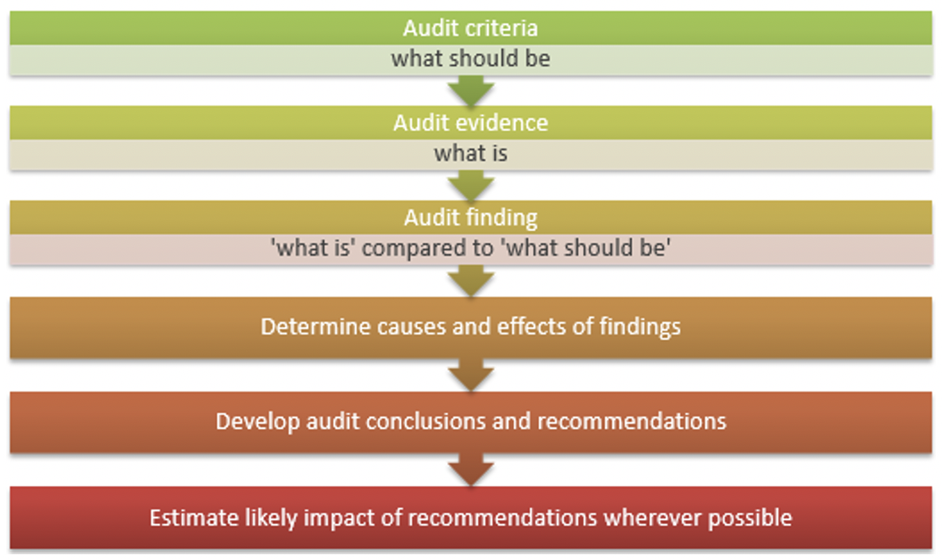

Slide 36
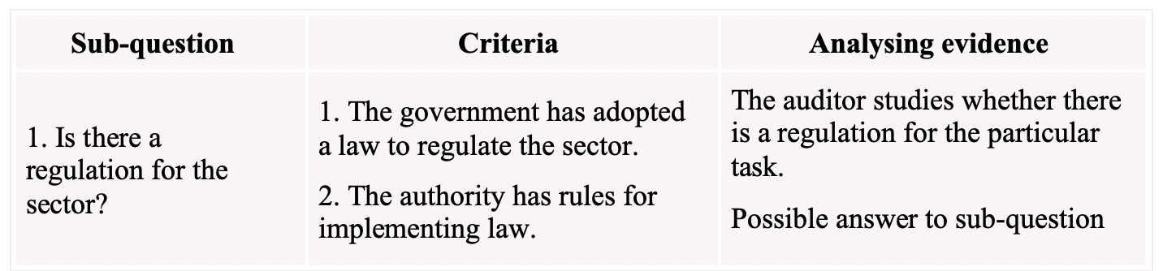
Analysing relationships between audit questions, sub-questions and criteria:

Slide 37
During analysis, we need to pay attention to the quality of data.
Conclusions are only as good as the quality of the information itself. Auditors often have to limit themselves to criticising the quality of data, which does not allow further conclusions to be drawn.

Slide 38
Preparing a report
Requirements for audit report
The audit report must provide well-founded, objective and complete information, analysis and assessments that add value for decision-makers and stakeholders. Expectations for an audit report are generally very high and mistakes therefore need to be avoided.
The report also needs to be convincing and persuasively presented, following the discovered facts. At the same, it must be objective and balanced in content and tone. In order to increase the impact of the audit report, it needs to be written clearly and in an easy-to-read manner. The report also needs to be concise; no longer than necessary to convey and support the message.
An audit report must always be accurate, true, comprehensive and complete, containing all of the relevant information and arguments to support the audit message.

Slide 39
Criterion-condition-cause-effect
To structure the paragraphs in an audit report, it is useful to follow a criterion-condition-cause-effect structure. Below is an example of using a table to analyse results and eventually develop a chapter for a report.
Step 1: Analyse the findings and sort the criteria, conditions, cause and final effect in a table, thus organising the statements in a logical order. It is often not easy to understand whether a finding is a cause or a final effect. The reason for this is that final effect may be a cause for the next condition. All of these relations between the findings need to be analysed with care.

Slide 40
Step 2: Extract the statements from the table and arrange them as a bullet-point list. If the sequence of statements does not flow logically, you will need to return to the table. Maybe you did not put the condition, cause and effect in the right cells.
Step 3: It is easy to develop a paragraph from the bullet-point list.

Slide 41
This method has proven useful for the initial analysis of findings as it is minimal and does not demand too much time or effort, being a short text. Of course, you may rewrite the paragraph and add examples or further reasoning to the final text.
By considering criteria, conditions, causes and effects while analysing audit findings, an auditor will end up writing a logically constructed report that is likely to have greater impact.

Slide 42
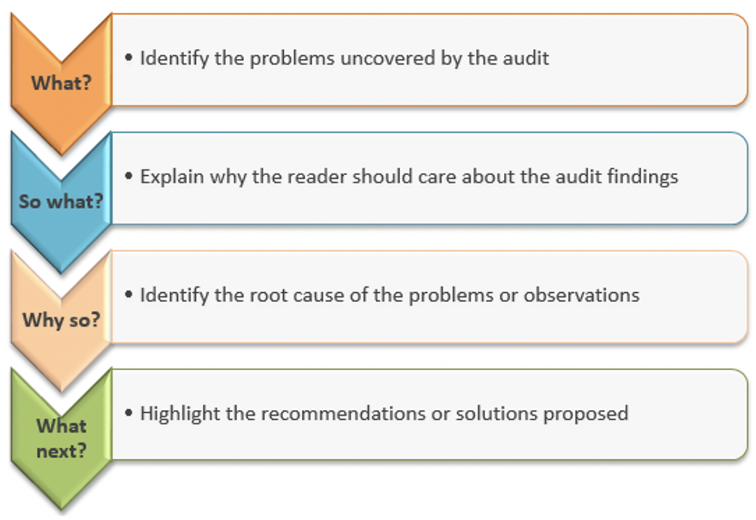
In order to increase the impact of environmental audits, the audit report should answer the following questions:

Slide 43
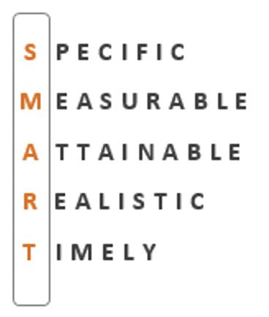
Recommendations The auditor's conclusions and recommendations are important aspects of an audit and, where appropriate, are written as a guide for action. Recommendations should be linked to the audit objectives, findings and conclusions. Besides being constructive and realistic, they should address the problems identified by the audit. The likelihood of having an impact is greater if recommendations are discussed with the auditee. Effective recommendations are:

Slide 44
Publishing an audit report and communicating audit results
Communication of audit results
It is good practice to present the audit report to the relevant parliamentary committee for consideration, to the auditees for their information and to the media for introducing it to the general public.

Slide 45
State Audit Institutions usually issue press releases and post full audit reports on their websites. A good press release related to the environmental topic should draw attention to which environmental problem the audit helps solve and why it is important.
Social media channels, such as Facebook, Twitter, YouTube, are used to present the results of the audits.

Slide 46
Publishing an audit report is an important stage, as it initiates public discussion on the issues uncovered. Some issues are of high interest to the public and broad-ranging discussions may enhance improvements in the area audited.
It is advisable to plan communication in advance and to be ready to respond to enquiries from the media without significant delay.

Slide 47
Visualization
It is important to make audit reports attractive to read. One option for this is to use visual elements because “a picture is worth a thousand words”.
Please note:
Different ‘products’ can be used to present the audit results depending on the audience or the mode of presenting information, e.g. 1–2 pages with visual elements, interactive infographics on the website, tweets, videos or short summaries and articles on social media.

Slide 48
Follow-up activities
After an adequate period of time has passed, it is necessary to follow up on the fulfilment of recommendations with the audited organisations.
A few months/a year after completing the audit it is good practice to gather feedback from the auditees. This could be done, for instance, as a survey or a follow-up meeting. In order to receive a comprehensive response, it is advisable to gather feedback from as many sources as possible.

Slide 49
Once a couple of years have passed since the audit, the auditors should consider whether it is necessary to conduct another audit on the same topic. Although a previously conducted audit provides valuable input for planning the next one, the next audit plan cannot merely be a copy of the previous one.
It must be kept in mind that the implementation of IT programmes and projects takes time, and it takes even longer to see actual results in the changes in practices (e.g. citizens behaviour). Therefore, it is important to keep a close eye on long lasting projects (e.g. the electronic government) or long-term objectives (e.g. digitization of working environment by 2030).

Slide 50
Thinking exercise:
Read one of the CAG press releases. Is it clear why this audit was conducted and what the main results were?

